Slide 1
OOP
WEEK07 MUHAMMAD NAEEM AKHTAR

Slide 2
Contents
07 | Operator Overloading continued (==, >=, <=, ==) Stream Insertion << , Stream Extraction >> | Text Book Chapter: 11 | Quiz: 02
 | Has-a relationship | Text Book Chapter: 10 Section: 10.3

Slide 3
Operator Overloading in C++
In C++, we can make operators work for user-defined classes.
This means C++ has the ability to provide the operators with a special meaning for a data type, this ability is known as operator overloading.
For example, we can overload an operator ‘+’ in a class like String so that we can concatenate two strings by just using +.
Other example classes where arithmetic operators may be overloaded are Complex Numbers, Fractional Numbers, Big Integer, etc.

Slide 4
Operator Overloading in C++
Operator overloading is a compile-time polymorphism.
It is an idea of giving special meaning to an existing operator in C++ without changing its original meaning.
Example:
int a; float b,sum; sum=a+b;
Here, variables “a” and “b” are of types “int” and “float”, which are built-in data types. Hence the addition operator ‘+’ can easily add the contents of “a” and “b”. This is because the addition operator “+” is predefined to add variables of built-in data type only.

Slide 5
Operator Overloading in C++
Now, consider another example
class A {
//somecode
};
int main() { A a1,a2,a3; //error
a3= a1 + a2;
return 0; }
Notes:
In this example, we have 3 variables “a1”, “a2” and “a3” of type “class A”. Here we are trying to add two objects “a1” and “a2”, which are of user-defined type i.e. of type “class A” using the “+” operator. This is not allowed, because the addition operator “+” is predefined to operate only on built-in data types. But here, “class A” is a user-defined type, so the compiler generates an error. This is where the concept of “Operator overloading” comes in. Now, if the user wants to make the operator “+” to add two class objects, the user has to redefine the meaning of the “+” operator such that it adds two class objects. This is done by using the concept “Operator overloading”. So the main idea behind “Operator overloading” is to use c++ operators with class variables or class objects. Redefining the meaning of operators really does not change their original meaning; instead, they have been given additional meaning along with their existing ones.

Slide 6
Example
Overloaded operator function can be member function of class or friend function.
Overloading + operator
Syntax
Return_type Class_Name :: operator symbol (argument list)
Box operator+(const Box&)
See operator_overloading_plus1,2.cpp
Classname obj3=obj1+obj2
Compiler calls: obj4=obj1.operator+(obj2)

Slide 7
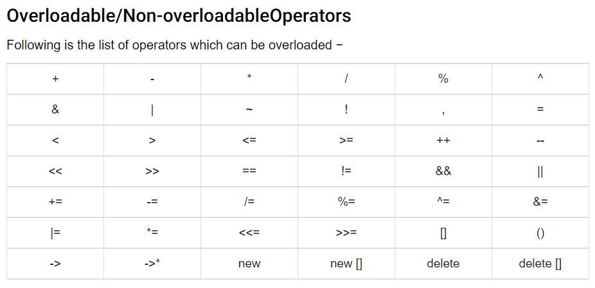
List of Operators Possible to Overload

Slide 8
List of Operators Can not be Overloaded
sizeof typeid
Scope resolution (::)
Class member access operators (.(dot), .* (pointer to member operator))
Ternary or conditional (?:)
Reading Assignment: Why we cannot overload above operators.

Slide 9
Rules for Operator Overloading
In C++, following are the general rules for operator overloading.
Only built-in operators can be overloaded. New operators can not be created.
Arity of the operators cannot be changed.
No. of operand an operator takes.
3) Precedence and associativity of the operators cannot be changed.
Precedence: a+b*c=b*c+a
Associative: a+b+c+d(left to right associcative)
4) Overloaded operators cannot have default arguments except the
function call operator () which can have default arguments.

Slide 10
Rules…
Operators cannot be overloaded for built in types only. At least one operand must be used defined type.
Assignment (=), subscript ([]), function call (“()”), and member selection (- >) operators must be defined as member functions
Except the operators specified in point 6, all other operators can be either member functions or a non member functions.
Some operators like (assignment)=, (address)& and comma (,) are by default overloaded.
Do not change natural behavior of an operator.

Slide 11
Overloading (==, >=, <=, ==)
< operator overloading: See example relational_01.cpp
Similarly we can overload remaining.
See example: relational_02,03,04.cpp

Slide 12
“<<”and “>>” operator overloading
See example: stream_01.cpp

